Slide 1
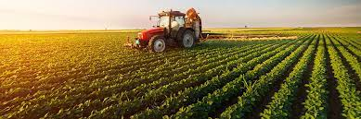
Sustainable and Smart Agriculture using AI and deep Learning

Slide 2
What is Artificial Intelligence ?
Artificial Intelligence(AI): refers to the simulation of human intelligence in machines that are programmed to think like humans, and the programs make the system AI-enabled.
The applications for artificial intelligence are endless. The technology can be applied to many different sectors and industries.
Notes:
Copyright © 2016 Accenture. All rights reserved.

Slide 3
Future farming system facing huge challenge
Agriculture
Agriculture sector is the foundation of the world
Mainstay occupations in many countries
80% of Livelihood depends on this
Rising Animal Protein consumption:
9% in 1965
14% in 2030
Rising Population
UN projection: increase from 7.5 billion to 9.7 billion by 2050
Survey:
Food production to be increased by 60% to feed additional 2 billion people
More pressure on land
Decline arable land
1 ACRE per person 1961
Less than 1/3 ACRE per person in 2050
Do more with less
Traditional Methods:
Not enough
Huge demands
Supply is getting harder
Notes:
Copyright © 2016 Accenture. All rights reserved.

Slide 4
Future farming system facing huge challenge
Current challenge:
Increase the global food production to 60% by 2050
Supply is getting harder
Harder to maintain yields
Harder to grow certain crops
Artificial Intelligence:
Steadily emerging
Technology evolutions are improving the productivity
Industry is turning to AI technologies
Farmers and Argo Companies:
Newer ways
Increase productions
Reduce waste
AI Powered solutions will enable farmers:
Optimized
Flawlessly execute every decision on the farm
Produce things in a sustainable manner
Improve quality
Faster go-to-market
Notes:
Copyright © 2016 Accenture. All rights reserved.

Slide 5
Artificial Intelligence in Agriculture
The Market study report stated that the global Artificial Intelligence (AI) in Agriculture market size is expected to reach 1550 million US$ by the end of 2025.

Slide 6
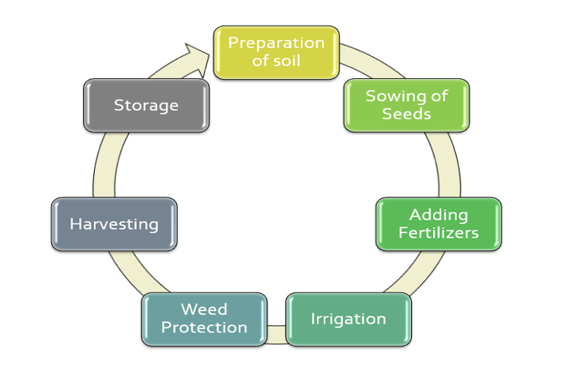
Life cycle of Agriculture
Notes:
WE can divide the process of Agriculture into different parts
Preparation of Soil:
- It is the initial stage of the farming

Slide 7
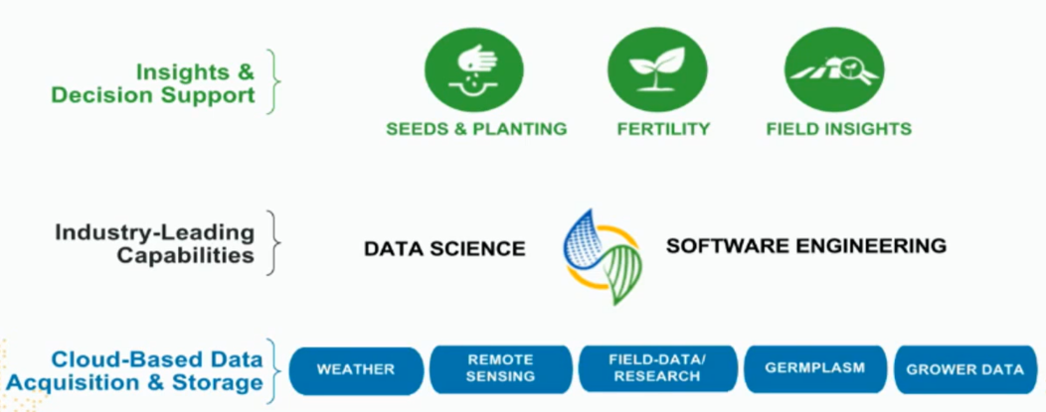
HOW ARTIFICIAL INTELLIGENCE CAN HELP
Notes:
We help them make decisions in a better way. We are focusing on seeding and planting decisions , their fertility decisions and helping them with field insights. Which is kind of targeting their most venerable area.
Through AI, we are building capabilities in data science as software engineers. Like everyone said here, getting the data is a very challenging part of the business, and I can think that we’re kind of you see the last layer where climate is the area where we have been investing a lot of time here. So we have data from weather , to remote sensing, to field data, to germplasm, so genetics is involved, and grower data.
It’s very similar to healthcare, we are helping growers to make decisions in a personalized manner right to actually making the decision in their field. In the world of healthcare , right now is moving in that directions, to help you make a decision about which treatment to get , which drug to take . It’s taking a similar view where they are looking at a system problem, right you have genetics, you have environment, you're trying to see how it interact with each other with a person. It’s very similar to the approach we’re taking and we’re trying to understand and it’s very complex. Just like healthcare, getting personalised medicine for you is hard. It’s very similar issue in agriculture.

Slide 8
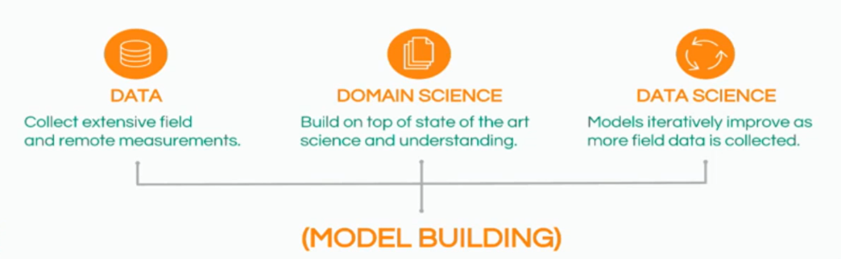
DATA SCIENCE IN AGRICULTURE
Notes:
How do we still tackle it. In climate we kind look at data science as a three-way problem. First you really do need the data, we have data from experiments, but I will challenge everyone to think that if you think worlds like marketing, google advertising and things like that where experiments can be run really often and you get feedback really often.
In agriculture that’s not the case. You can’t run an experiment really often. You put it in the field and it takes season and the season is a year, and hence no matter how much you water it, fertilize it. It’s just not going to grow fast, and so you have to have a year and so experiments are very cost-intensive in agriculture and very time consuming, and that is probably not the biggest the best way to get big data. So you get data from experiments, but it’s usually not huge.
The other way to get data is from either actual grower's rights. So, we do have thousands of growers who grow on thousands of acres. So you do the math, and you get a lot of data.
A similar kind of strategy that climate has been taking is helping growers get into a platform that really does get them a sense of understanding the data, better understanding the insight into the data and learning from each other.
So, we get the data, get the domain science, we do need domain experts in the agriculture business to understand things and to bring together statistician machine learners with domain experts because ultimately when we are working with the weather, we work with agriculture soil, we work with plant scientist, we need all these experts because we got the understanding that we cannot build black boxes
Our clients will not trust us if we build complete black boxes this is less of an issue I think, for if you google search, you really don’t care to google just invented a new algorithm it’s deep learning, it’s the new search engine you’re like I’m going to get my result better
Growers are not going to respond that nicely to it. That’s their livelihood. They are not going to trust you just because built an awesome machine learning, deep learning, shallow learning, or wide learning algorithm. They’re not going to trust you because you say it’s working.
There is back testing; there is the right way of doing this to prove and the way to prove it is to wait for a year and so or maybe several years and so it’s a hard problem.
One of the ways we have tackled it is to bring the domain scientists internally and try to build models which have explanatory value in them
The last piece is a data scientist, and we have our team this way. We have domain scientists and data scientists, and engineers all sitting in one team.

Slide 9
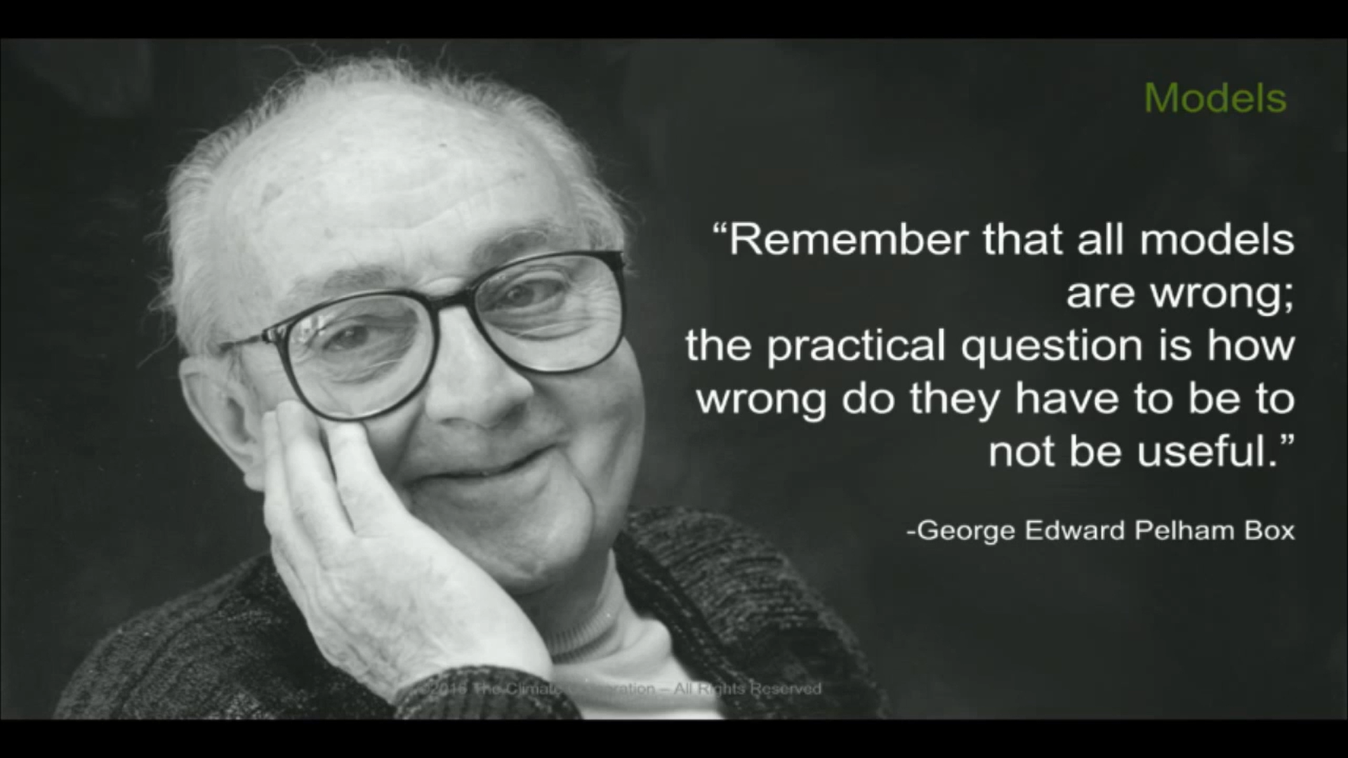
Notes:
All models are wrong but some models are little bit more practical than others so we should use those. We lead that kind of mantra in the company where we believe we need to build models, but we also need to understand their vulnerability , understand when they are going to work and when they are not going to work so well and learn how to protect that kind of problem.

Slide 10
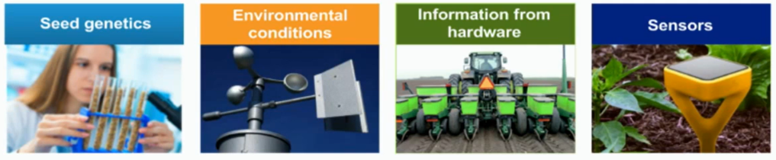
OUR DIVERSE DATA
Monitoring system
Notes:
WE have lots of data, so we build models. We’ve lots of data just to give you some sense. We good seed genetics phenotype, genotype kind of information on different seeds
We monitor we have our own monitoring systems, and we also tap lots of publicly available environmental conditions data .
Then you look at this tractor. You know how many sensors are on this tracker. There are hundreds of sensors on one harvester or single harvester. The amount of data that today that is being collected from harvesters and planters is insanely rich.
With this rich, rich dataset that sensors are collecting today in real-time, you can see how people are planting, what they are planting, how much they’re planting, and how much space there is between seeds like it. So, it’s a really rich data sets
And then we have ground sensors obviously for soil moisture, for example, nitrogen, potassium, and other kinds of fertility information. We’re taking a system approach from all sides of the data.

Slide 11
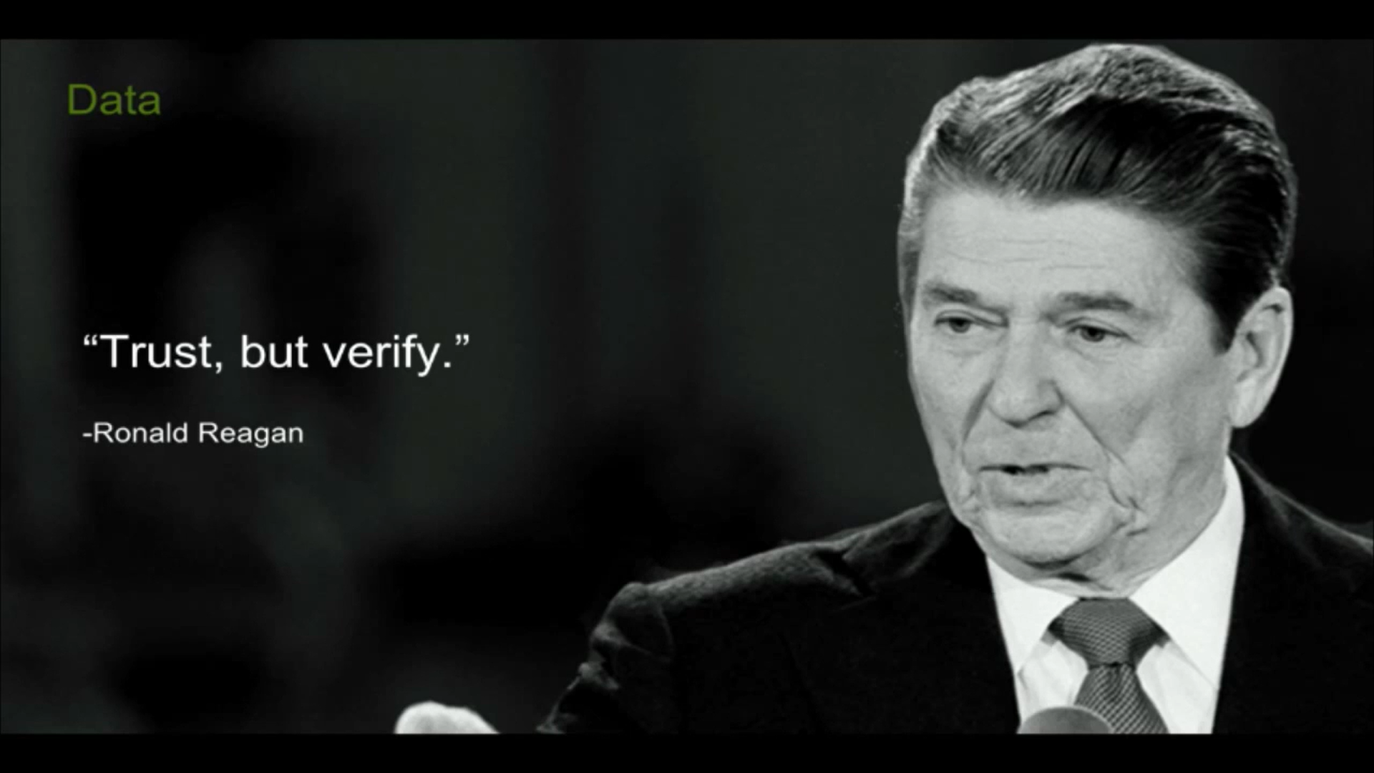

Slide 12
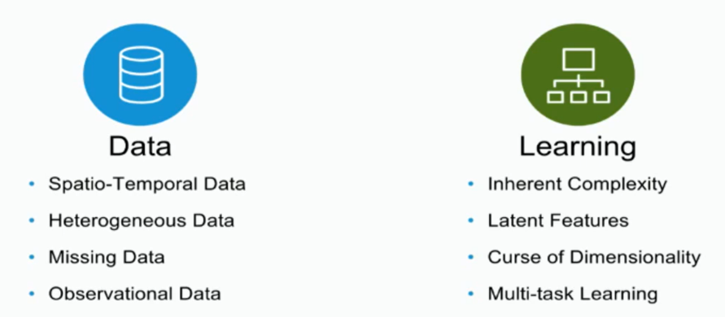
SCIENTIFIC CHALLENGES
Notes:
Scientific challenge range from a lots of things. So the data its spatio-Temporal in nature. I should have shown you data where we have data but it’s across the us, we have also in brazil, we’ve got Canada, we’ve got even in Europe and some of our data , so It very diverse,
It’s horribly heterogeneous. So temporally sometimes we have every minute, every hours and sometime we have every day and every week, and once a month. So it’s really not beautiful.
Spatially it’s same there is county level data , there’s country level data, but there is also like I said the sensors are producing data.
There are lots of missing data, Observational study . So you know that you cannot make lots of assumptions that you’re controlling like an experiments and that come with it own biases and problems
Learning features is hard, there’s lots of multi-task learning that we need to do. There are lots of latent features that we need to uncover. For example, think of the simplest problem we want a model yield, end of a season, everyone says that the weather will affect, it okay, how would you, or what’re the features that you should put into the model yield, I challenge anyone in the room to try. It’s a challenging problem knowing which features should go in. Some models are now tackling it by trying to do it automatically obvious, but I will tell you that growers won't like the idea. You have to be able to explain why precipitations in the second week after planting is an important variable. So, these are the kind of challenges we have
Spatial-temporal modelling relates to problems where we want to analyse and predict how something varies over space and/or time.
latent features are 'hidden' features to distinguish them from observed features. Latent features are computed from observed features using matrix factorization. An example would be text document analysis. 'words' extracted from the documents are features

Slide 13
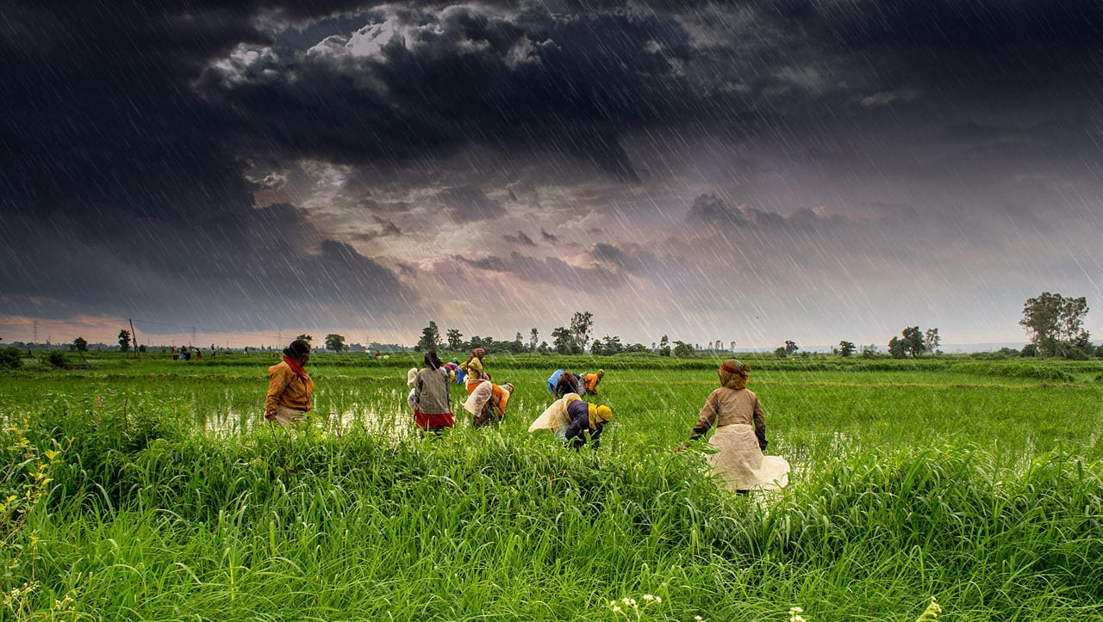
Industry USE CASES

Slide 14
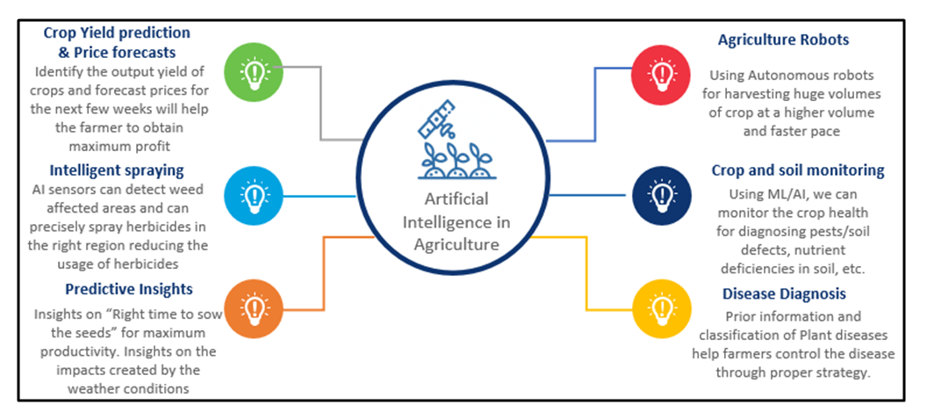
summary
Notes:
Copyright © 2016 Accenture. All rights reserved.

Slide 15
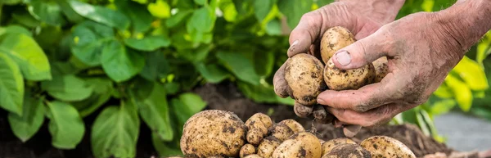
USE CASE - Potato Disease Prediction

Slide 16


Data Collection
Data Preprocessing
Cache, Shuffle, and Prefetch the Dataset
Resizing and Normalization
Data Augmentation
Model Architecture
Building the Model
Compiling the Model
Train and Test the Model
Model Prediction
Saving the Model
Creating different versions
Overview

Slide 17
Pre-requisite
Python Basics
Numpy
Pandas
Machine Learning
tensorFlow
Deep Learning Basic
Convolutional Neural Network(CNN)
Notes:
Pre-requisites for the Project

Slide 18
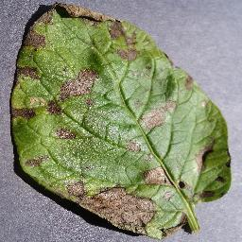
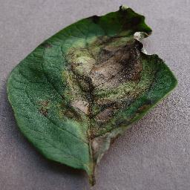
Problem Statement
Framer who grows potatoes are facing lots of economic losses every year because of various diseases that can happen to a plant.
There are two common diseases known as ‘Early blight and Late blight
Prior information and classification of Plant disease help farmers to control the disease through proper strategy
Early_blight
Late_blight
Notes:
Early blight is caused by fungus
Late blight is caused by specific micro-organisms
If a farmer can detect these diseases early and apply the appropriate treatment. It can save lots of waste and prevent economic loss.
The treatment for early blight and late blight is a little different. So, it’s important that you accurately identify what kind of disease is there in the potato plant.

Slide 19
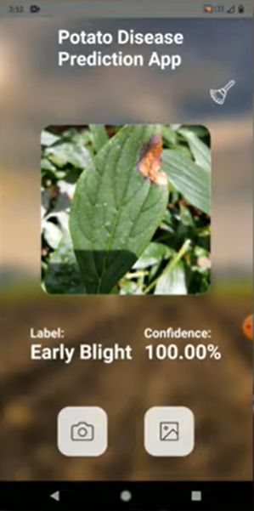
Potato Disease Prediction App

Slide 20
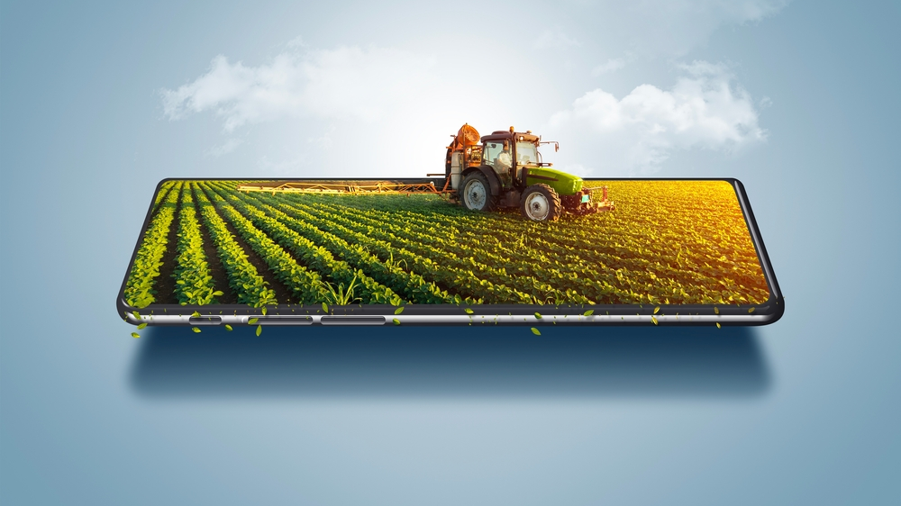
Data Collections
Notes:
Any supervised learning start with data collections . Data that you can use as a training data set.

Slide 21
Data Collection
Buy data from a third-party vendor
Collect and annotate data on your own
Manual
Expensive project needs budget
Approval from Stakeholders
Time-consuming
Write web scraping scripts to collect images from the internet
Tool like Docano to annotate
Get the annotated images by web scraping tools
Get ready-made data from Kaggle

Slide 22
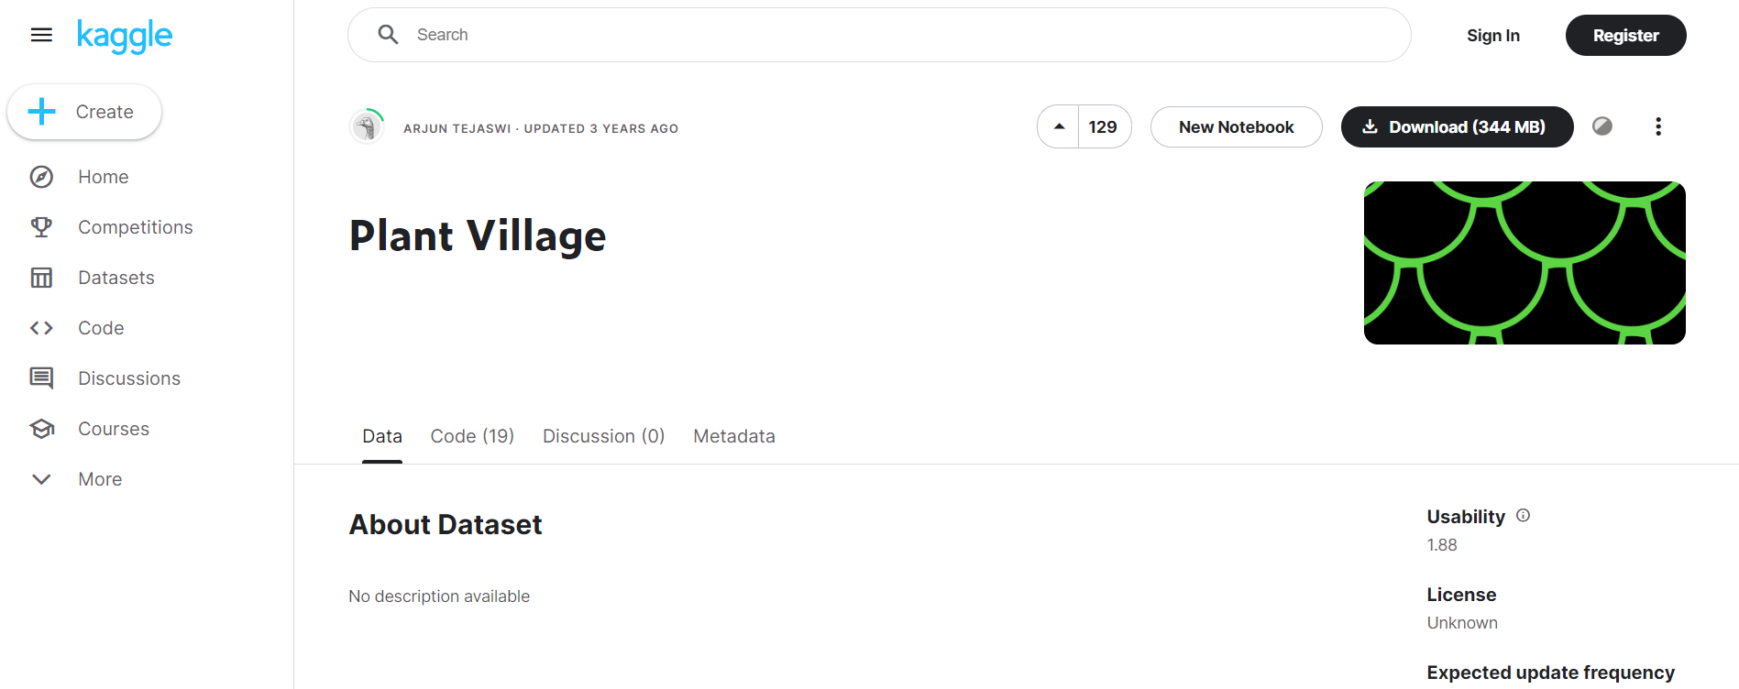
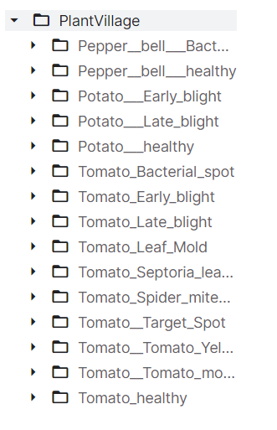
Dataset taken from Kaggle: https://www.kaggle.com/datasets/arjuntejaswi/plant-village

Slide 23
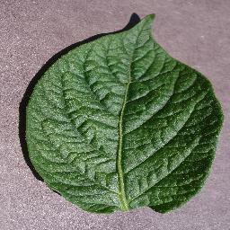
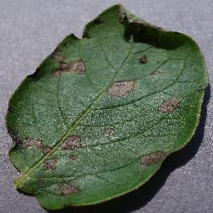
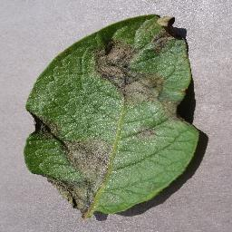
Data Collection
Potato Disease classification Project
Healthy
Early Blight
Late Blight
Notes:
Any supervised learning start with data collections . Data that you can use as a training data set. In our case we need to collect the images of a health potato plant leaf. And the potato plat leaf which has early blight or a late blight disease.

Slide 24
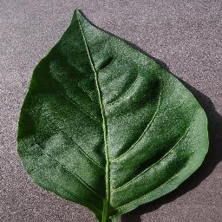
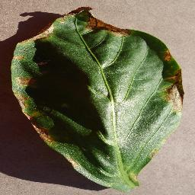
Data Collection
Pepper bell Disease classification Project
Pepper__bell___healthy
Pepper__bell___Bacterial_spot
Notes:
Any supervised learning start with data collections . Data that you can use as a training data set. In our case we need to collect the images of a health potato plant leaf. And the potato plat leaf which has early blight or a late blight disease.

Slide 25
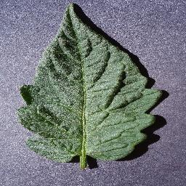
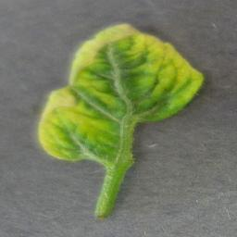
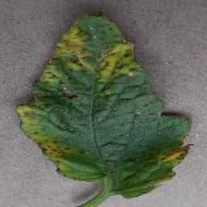
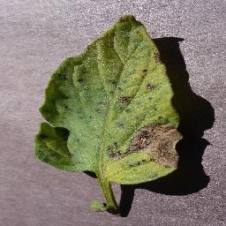
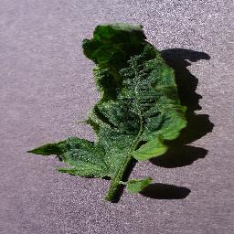
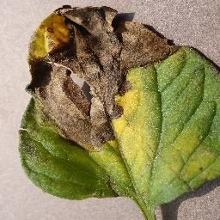
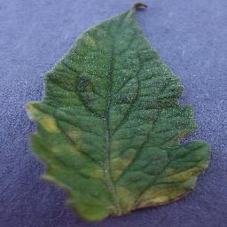
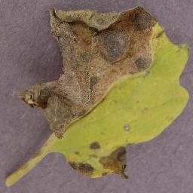
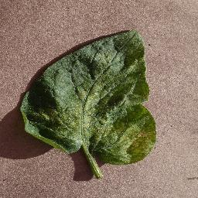
Data Collection
Tomato Disease classification Project
Tomato_healthy
Tomato_YellowLeaf__Curl_Virus
Tomato_Bacterial_spot
Tomato_Early_blight
Tomato_mosaic_virus
Tomato_Late_blight
Tomato_Leaf_Mold
Tomato_Septoria_leaf_spot
Tomato_Spider_mites_Two_spotted_spider_mite
Notes:
Any supervised learning start with data collections . Data that you can use as a training data set. In our case we need to collect the images of a health potato plant leaf. And the potato plat leaf which has early blight or a late blight disease.

Slide 26
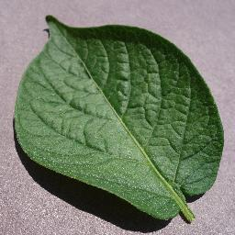
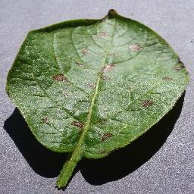
Model Building
Data Cleaning & Processing
Model Building
Potato leaves sample
tf dataset
CNN
models
Data augmentation
Notes:
Let’s say that you have covered all these images. Then come the data cleaning and preprocessing step, for which we will use the tf dataset and data augmentation. Data augmentation because we might not have enough diverse sets of images. We need to rotate and flip, and you know, adjust the contrast to create more training samples.
Once we have that, we will use model building using CNN (convolution neural network). CNN is a standard way of doing image classifications as of 2022 and, therefore will be using CNN and then exporting the trained model to our disk.
Then we will cover some of the ML-Ops concepts using tf-serving, where we’ll have a TF serving server running on top of these exported models. Which can serve a different version of these models, and tf-serving will be called using Fast API.
Now you will be asking why we are using tf-serving and fast API both. Don’t worry. We can have just the Fast API server without using tf-serving. We will cover both approach and you will understand the benefit of having TF serving in addition to fast serving.
Then you can build a website in react JS. React Js is a hot technology as of today for doing website development . That will be calling the Fast API server where you drag and drop images and tell you the label. Whether it is health, Early blight or late blight.
Now comes the interesting thing mobile app development. We will do website development and then we will test things in our local computer and when we are ready to go then we will move to mobile app development.

Slide 27
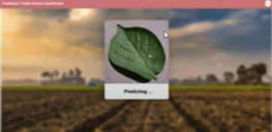

Web App Development
Data Cleaning & Processing
Model Building
tf Serving
http://localhost:8501
Potato leaves sample
tf dataset
CNN
models
Data augmentation
ReactJS
Notes:
Let’s say that you have covered all these images. Then come the data cleaning and preprocessing step, for which we will use the tf dataset and data augmentation. Data augmentation because we might not have enough diverse sets of images. We need to rotate and flip, and you know, adjust the contrast to create more training samples.
Once we have that, we will use model building using CNN (convolution neural network). CNN is a standard way of doing image classifications as of 2022 and, therefore will be using CNN and then exporting the trained model to our disk.
Then we will cover some of the ML-Ops concepts using tf-serving, where we’ll have a TF serving server running on top of these exported models. Which can serve a different version of these models, and tf-serving will be called using Fast API.
Now you will be asking why we are using tf-serving and fast API both. Don’t worry. We can have just the Fast API server without using tf-serving. We will cover both approaches and you will understand the benefit of having TF serving in addition to fast serving.
Then you can build a website in react JS. React Js is a hot technology as of today for doing website development. That will be calling the Fast API server where you drag and drop images and tell you the label. Whether it is health, Early blight or late blight.
Now comes the interesting thing mobile app development. We will do website development and then we will test things in our local computer and when we are ready to go then we will move to mobile app development.

Slide 28
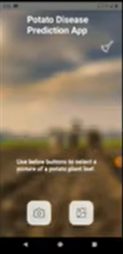
Mobile App Development
Tf light models
Data Cleaning & Processing
Model Building
Quantization
Potato leaves sample
tf dataset
CNN
models
Data augmentation
Google cloud functions
React Native
GCP
Notes:
We keep the architecture the same till this point, but then we convert these exported float models into Tf lite models using quantization.
But quantisation is a way to reduce the size of your models .so that your model occupies less memory. You can deploy it on a cell phone on an edge device, and the inference speed is much faster.
Once we have exported tf lite models, then we can deploy those to Google cloud, and we will write Google cloud functions which are similar to AWS lambda. If you have heard about serverless architecture and aws lambda. So, google functions are kind of like that and then these google functions will be serving our cool mobile applications.

Slide 29
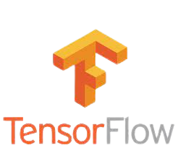



CNN (Convolutional Neural Network
Data augmentation
tf dataset
Model Building
tf serving
Backend Server
Quantization
Model Optimization
Frontend
&
Deployment
React JS
React Native
Deployment to GCP
Notes:
Model Building:
In terms of the technology stack for the Model building, we will use TensorFlow, CNN, data augmentation and tf dataset
Backend
For the backend server or ML Ops, we will be using tf-serving and FastAPI
Model Optimization:
Regarding model optimization, we will be using quantization along with TensorFlow lite.
Frontend & Model Deployment
For frontend and deployment, we are using ReactJs for the website and ReactNative for Mobile APP

Slide 30
DEMO
Notes:
Any supervised learning start with data collections . Data that you can use as a training data set.

Slide 31
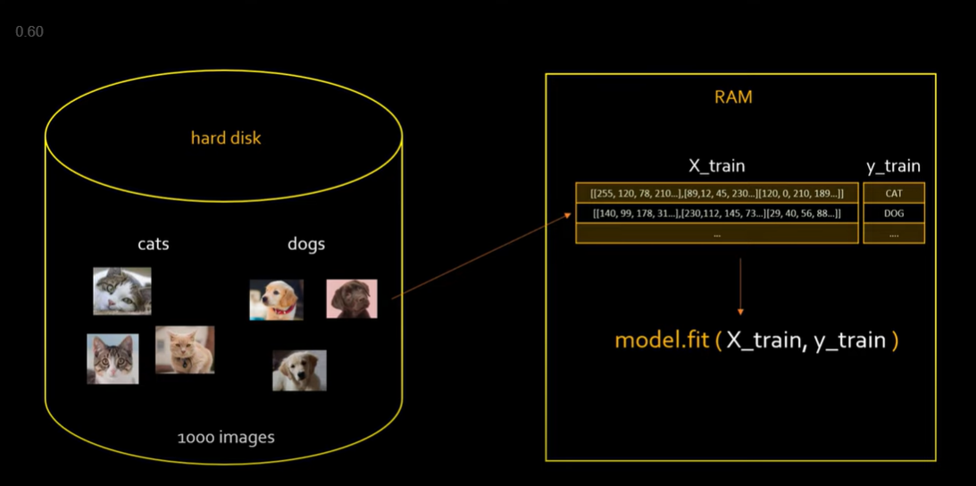

Slide 32
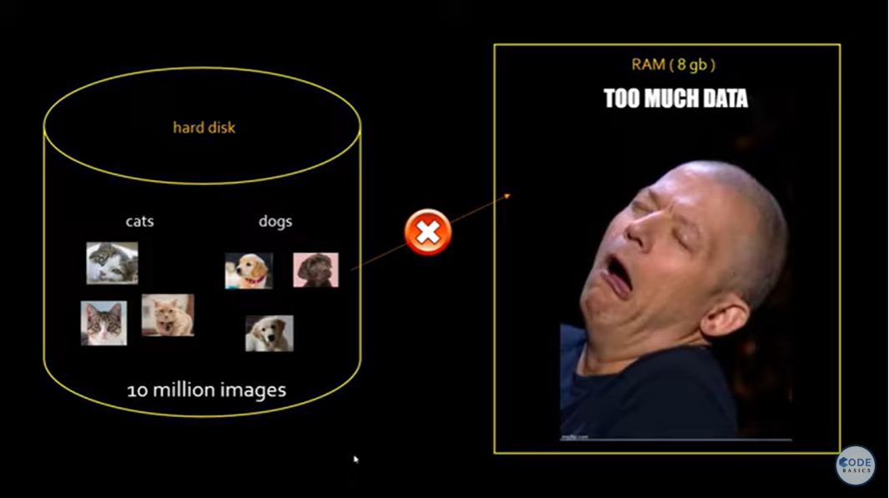

Slide 33
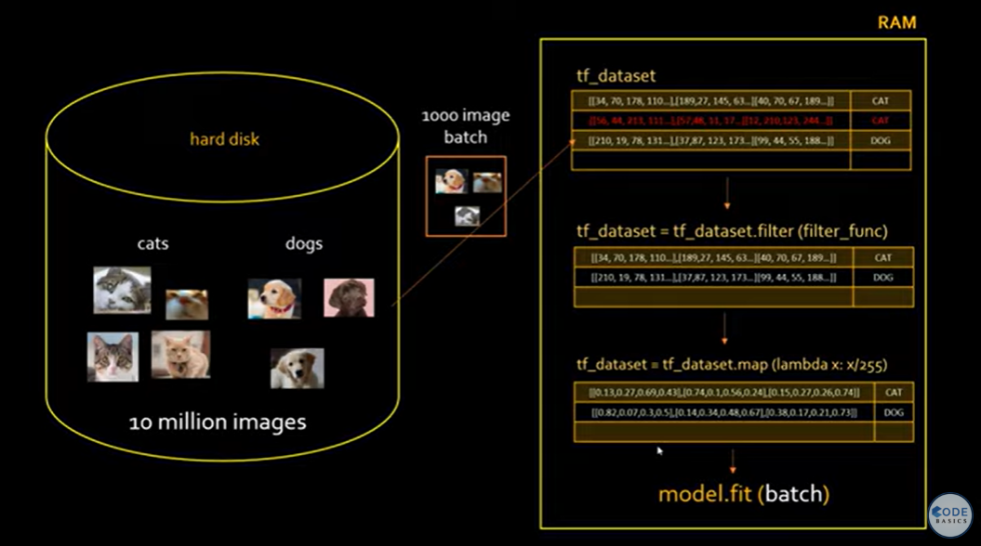
Notes:
Therefore, the tf.data.dataset is quite useful because it can load these images into the batches and then train the model on them. You load 1000 images you give batch1 for model training, then you do batch2, batch3, batch4 and so on, and things work perfectly ok. This is called the streaming approach, Batch1 has 1000 images .You load them into some kind of special data structure. By the way this table is not your Numpy array or pandas dataframe. This special data structure is nothing but tf.data.Dataset.
I don’t want to load the images directly and do my model training because you all know we have to do data cleaning, data transformation, scaling data, and things like that. tf. dataset, fortunately, has lots of good APIs to support the transformation. So, e.g., We have the red row for the blurry image. You can use a filter to remove the blurry image. filter_func is a custom function defined by you which will detect whether the image is blurry or not.
You can see that the red row is gone now in this data structure, and then you can do model training. You might want to do more transformations let’s say you want to scale it . All the values you want to scale If you have noticed, all these images are 3-dimensions arrays. So an image is represented by an RGB channel and these values are from 0 to 255 and it’s a usual practice that we scale this by dividing it by 255. Now you can do tf_dataset.map(lambda x: x/255) it will divide each of these values by 255. for eg 34/255 = 0.13, 70/255 = 0.27
And then you can do your model training . You can use tf.dataset to do fiktering, mapping , shuffling and lots of different transformations
This is what helps you to build a TensorFlow pipeline. To build this, you need to use tf.Data API framework. And tf.data.Dataset is the main class in this framework.

Slide 34
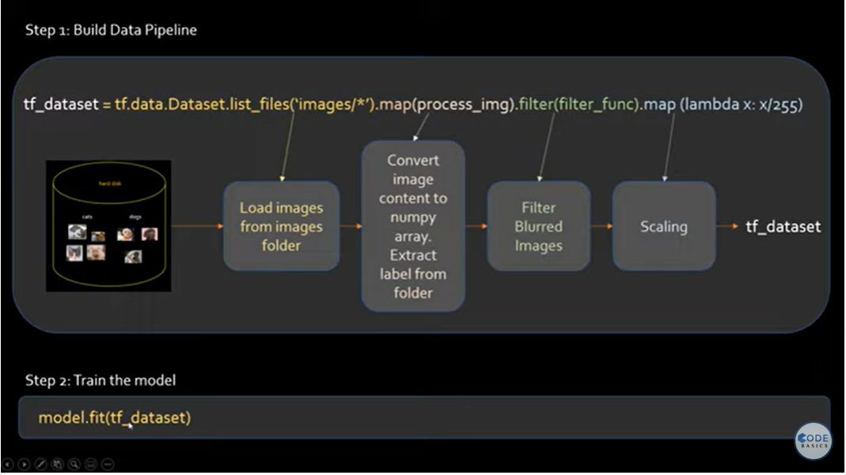
Notes:
What if I can write all the transformation into one single line of code.
This is forming your data pipeline ,
List_file(‘images/*) This will load the images from your hard disk into memory okay.
Map(process_img) : Then you do the map. Doing a map is like an apply function in pandas where you want to run some transformations on your image. I probably want to convert them into a NumPy array and then do some transformations. By the way, Numpy array is internally inside your tf_dataset. So tf_dataset is providing some abstraction over it. So essentially, your numpy is converted into a tensor object, and the tensor is an underlying data structure for tf_dataset.
Now you have converted these images to a Numpy array, extracted the label from the folder, and then the next step will be filtering the blurred images, and then you do the mapping. In mapping, you are just scaling it. Which will bring the values between 0 and 1.
In this pipeline, you perform ETL(Extract Transform and Load) all kinds of transformations. I just showed a few transformations.
The next step is to train the model.

Slide 35
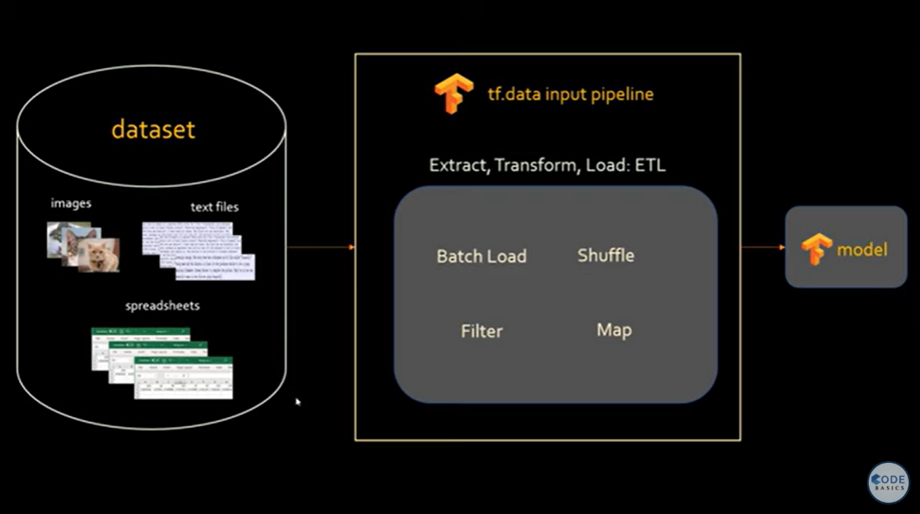

Slide 36
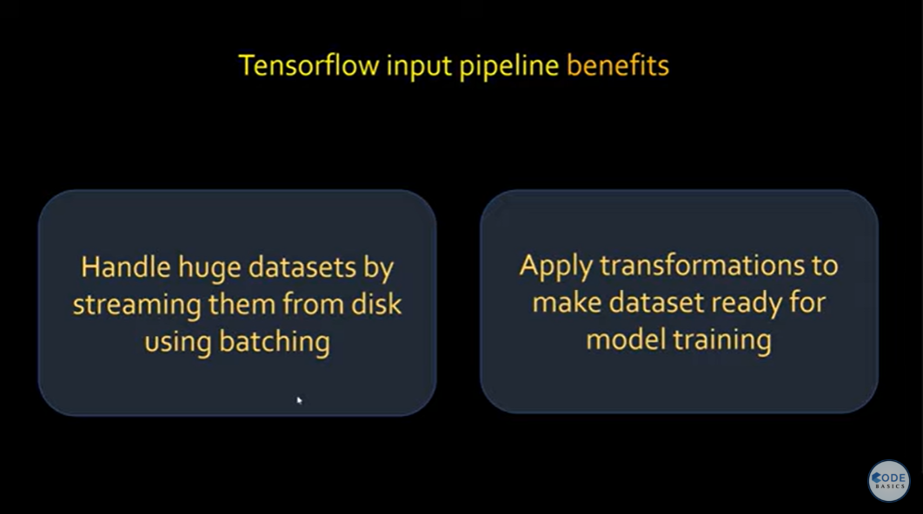

Slide 37
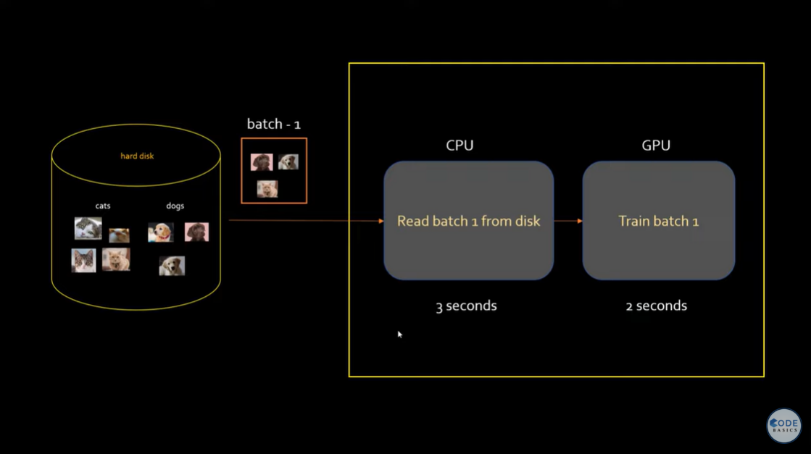
Prefetch
Notes:
Prefetch: , if your are using CPU and GPU for training. If your GPU is busy training. pre-fetch will load the next set of batch from your disk and that will improve the performance

Slide 38
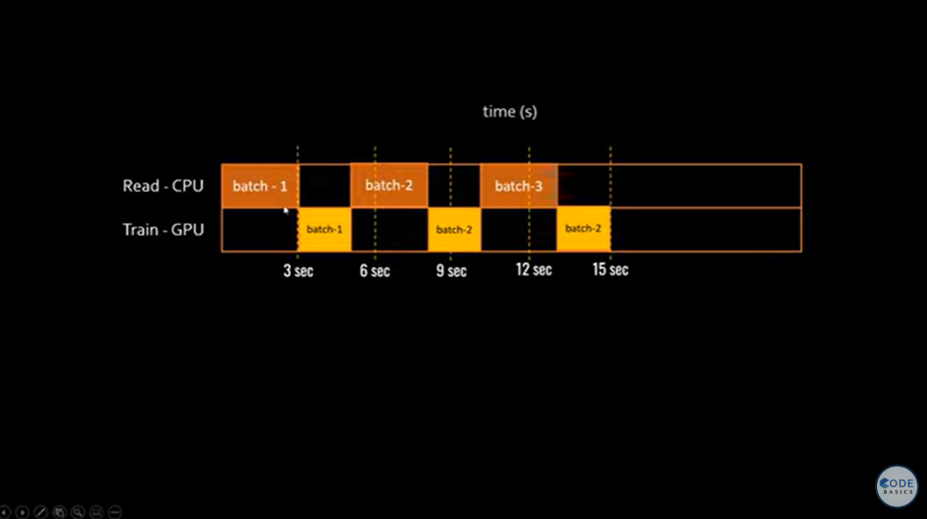
Prefetch
Notes:
Prefetch: , if you are using CPU and GPU for training. If your GPU is busy training. pre-fetch will load the next set of batches from your disk, and that will improve the performance. Both GPU and CPU are working together.

Slide 39
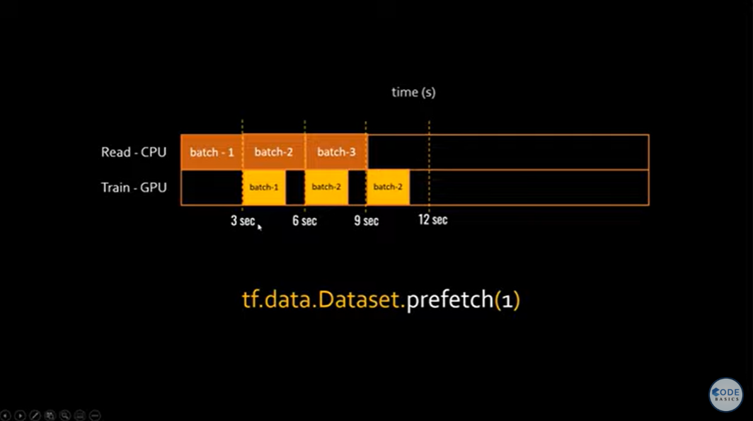
Prefetch

Slide 40
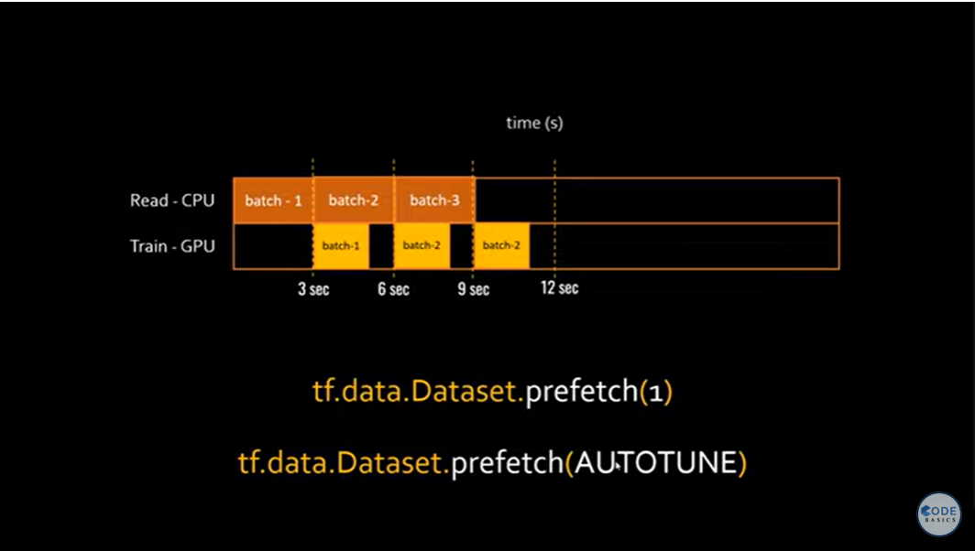
Notes:
tf.data.AUTOTUNE - I am allowing tensorflow how many batches to load while GPU is training.

Slide 41
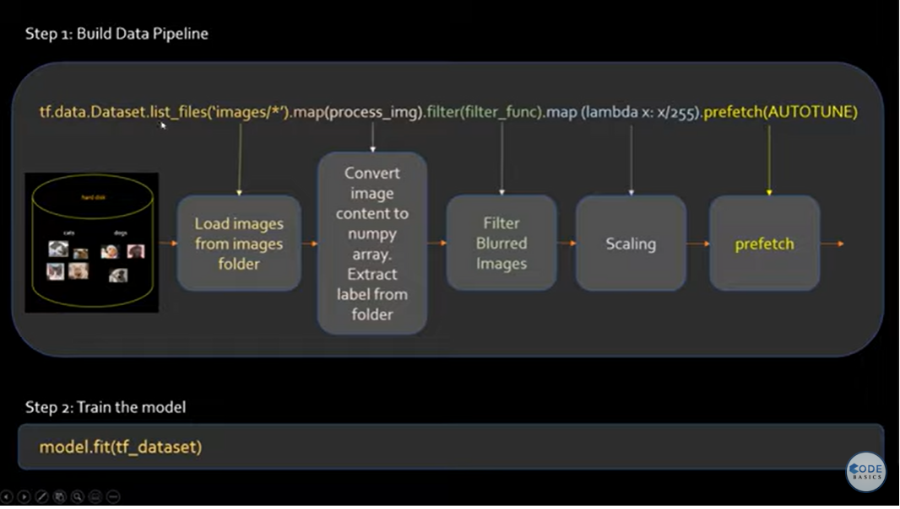
Prefetch
Notes:
tf.data.AUTOTUNE - I am allowing tensorflow how many batches to load while GPU is training. You want to make optimal use of your hardware resources and pre-fetch allows you to do that.

Slide 42
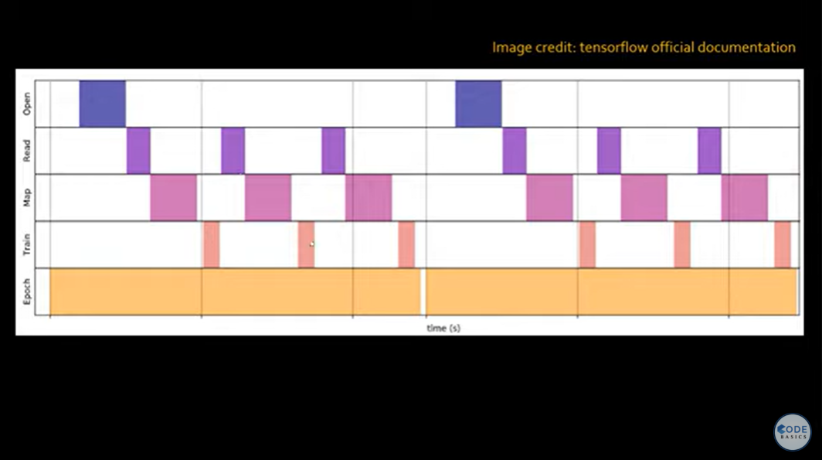
Cache

Slide 43
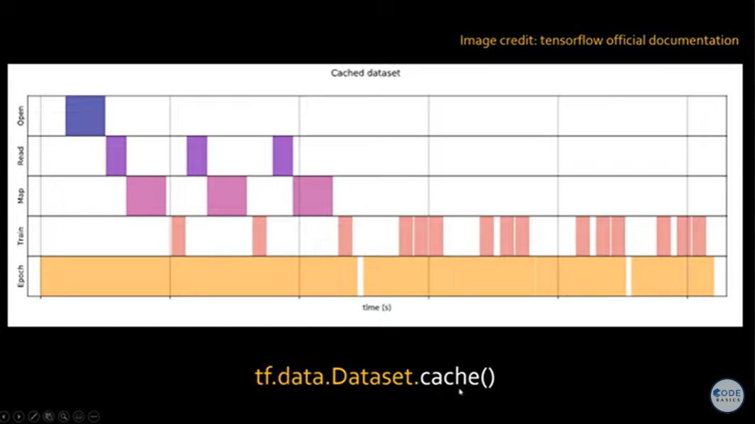
Cache
Notes:
Cache: It will read the image from the disk and then for the next iteration when you select the new image. It will keep the image in the memory. This improves the performance of your pipeline.

Slide 44
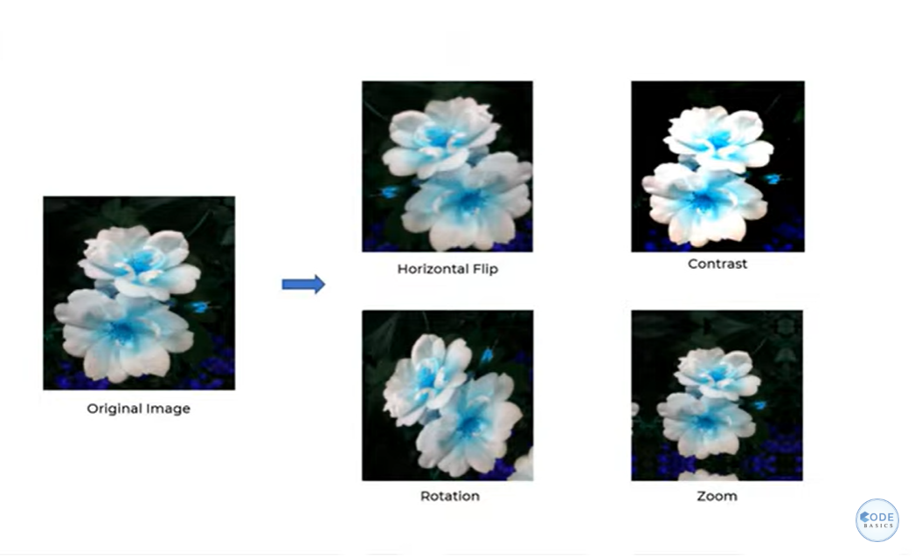
Data Augmentation
Notes:
Data Augmentation
Data Augmentation is needed when we have less data, this boosts the accuracy of our model by augmenting the data.
What we do is let’s say if have this original image in your training dataset. you create four new samples training samples out of that. You apply different transformation let's say horizontal flip, contrast. you see contrast is increased in this image. So, You taking same image you applying some filter, some contrast, some transformation, you are generating new training samples. See here I rotated the images, and now i will use all five images for my training. I have one image i have created four extra image. I used all 5 images for my training. So that my model is robust. So tomorrow, when I start predicting in the real world if someone gives me rotated image my model knows how to predict that. That's the idea behind data augmentation

Slide 45


Slide 46


Slide 47


Slide 48


Slide 49


Slide 50


Slide 51


Slide 52


Slide 53


Slide 54


Slide 55


Slide 56


Slide 57


Slide 58


Slide 59


Slide 60


Slide 61


Slide 62


Slide 63

Notes:
Neural Networks are used to handle the variety of inputs such that they can generically classify those varieties of inputs.

Slide 64

Notes:
Here the first part we used convolution operations is feature extraction part and the second portion is the where we are using dense neural network is called classifications because the first part is detecting all the features eyes, nose, ears, hands and legs. Second part is responsible for classification.

Slide 65

We use ReLu to bring nonlinearity to our model.
Feature Map
Feature Map
Notes:
We use reLu to bring nonlinearity in our model. What it will do is it will take the feature map. Whatever negative values are there. It just replaces that with zero. If the value is more than zero it will keep as it is.

Slide 66



Slide 67


Slide 68


Slide 69

Max pooling

Slide 70


Slide 71

Location invariant
Feature Map
Feature Map
Reduce size

Slide 72


Slide 73


Slide 75


Slide 76


Slide 77


Slide 78
Data Augmentation
Notes:
Data Augmentation
Data Augmentation is needed when we have less data, this boosts the accuracy of our model by augmenting the data.
What we do is let’s say if have this original image in your training dataset. you create four new samples training samples out of that. You apply different transformation let's say horizontal flip, contrast. you see contrast is increased in this image. So, You taking same image you applying some filter, some contrast, some transformation, you are generating new training samples. See here I rotated the images, and now i will use all five images for my training. I have one image i have created four extra image. I used all 5 images for my training. So that my model is robust. So tomorrow, when I start predicting in the real world if someone gives me rotated image my model knows how to predict that. That's the idea behind data augmentation

Slide 79


